Slide 1
Applying to the ESRC
Professor Ron Carter
Research Grants Board

Slide 2
ESRC Principles
Quality - Funding research and training of the highest quality by world standards
Relevance - Focusing on areas of major national importance and key policy areas
Independence - Ensuring independence from political, commercial or sectional interests
Leadership and Collaboration -- interdisciplinarity/collaboration with business, government, third sector
Impact - increasing the flow of research from academia to the worlds of policy and practice

Slide 3
Key Priorities
Seizing new research opportunities and being responsive to both the social science research community and our wider stakeholders
Strengthening the social science research base – people, disciplines, data, methods and infrastructure
Operating in a global context – a commitment to the increasing internationalisation of all aspects of our work
Increasing non-academic impact (public policy/economic prosperity/culture/quality of life).
Notes:
Increase the flow of people between research and the worlds of policy and practice.
Why this background? Refer to Strategic plan in applications and show a wider awareness of RCUK priorities. Internships?

Slide 4
Facts and Figures (2008/09)
£88m invested in research
£44m invested in training
At any one time, the ESRC supports:
  Over 2,000 doctoral students
  Over 800 grants and fellowships
  350 projects within 20-30 managed programmes
  30 large scale research and resource centres
Over 120 institutions carry out research with ESRC funds

Slide 5
ESRC Strategic Plan 2009-2014
Strategic Aims
Impact through world class social science research
Impact through skilled people
Impact through world class infrastructure
Impact through international leadership
Impact through partnerships
Notes:
Current priorities:
- seizing new research opps and being responsive to soc sci community and wider stakeholders
- infrastructure/next generation of researchers/ capacity building
- strengthening social science research base
- internationalisation/ China
-partnerships = more interdisciplinarity/links with other Research Councils.

Slide 6
ESRC Strategic Plan 2009-2014
Priority Areas:
1. Global economic performance, policy and management.
2. Health and wellbeing
3. Understanding individual behaviour
4. New technology, innovation and skills
5. Environment, energy and resilience
6. Security, conflict and justice
7. Social diversity and population dynamics
Notes:
Directed v responsive-mode grants.
Note that ESRC is government funded. TSB oversees dealings with Research Councils/RCUK. TSB reports to DTI.

Slide 7
Examples of ESRC funding schemes
Open Schemes (response-mode):
  Research Grants
  Fellowships
One-off Schemes (directed-mode):
  Strategic initiatives/specific calls on highlighted areas
  relative to Strategic Plan
Annual calls:
  Seminars
  Centres
  Studentship Schemes

Slide 8
Funding options throughout a research career
On-going Training and Development
Professorial Fellowship
Centres
Large Grant
Mid-career Fellowship
Priority Networks/ Groups
Standard Grant
Small Grant
Postdoctoral Fellowship
First Grant Scheme
+3 Studentship
Research Opportunities
Research Masters
Notes:
This diagram tries to set out the researcher career, consisting of opportunities for research and personal development on either side of the line.
The point to make here is that ESRC is in it for the long-haul, and that the fellows are asked to go forward with us to create world class social science. ESRC has made a significant commitment to providing flexible and appropriate researcher-led opportunities to ensure that the best and most innovative social science is supported. This concept of building a lasting relationship with the research community is pivotal to our new flexible strategy.
Postdocs and professorial fellowships are separate competitions
- postdocs 4 times a year
- profs once a year (Nov)
But can apply for regular fellowships any time
First grants and large grants are also separate comps (once a year - possibly biennial?)

Slide 9
The Council’s Boards: 2009/10 budgets
Strategic Research Board - £35 million
Research Resources Board – £13-14 million
Training and Development Board - £45 million
Research Grants Board - £36 million
  Over 1,000 applications received each year
  Overall 18% success rate (reducing due to no of applications)
Notes:
Strategic Research Board - responsible for over fifty research centres, groups, priority networks and programmes.
Research Resources Board - responsible for developing essential resources such as data, research methods and information technology; also managing Resource Centres and Resource Programmes
Training and Development Board - provision of awards (or studentships) for postgraduate students and postdoctoral fellowships.

Slide 10
Responsive Mode/Open Call Grants Scheme
Project funding for up to 5 years
Open-date scheme
Small grants: £15k - £100k
Standard grants: £100k - £1.5m
Aim to make decision within:
  22 weeks for standard grants
  14 weeks for small grants
Stand-alone research projects
Notes:
Small grants can expect to start ~22 wks from submission; standard grants ~30wks

Slide 11
Lifecycle of a Standard Grant application
Application received in Registry
Application received in team
Case Officer checks
Referee selection
Office reject
Referee comments received
Referee reject
Award letter issued
Application unsuccessful
Assessor reject
Board assessor review
Decision letter sent to applicant
Application successful
Grants Board meeting

Slide 12
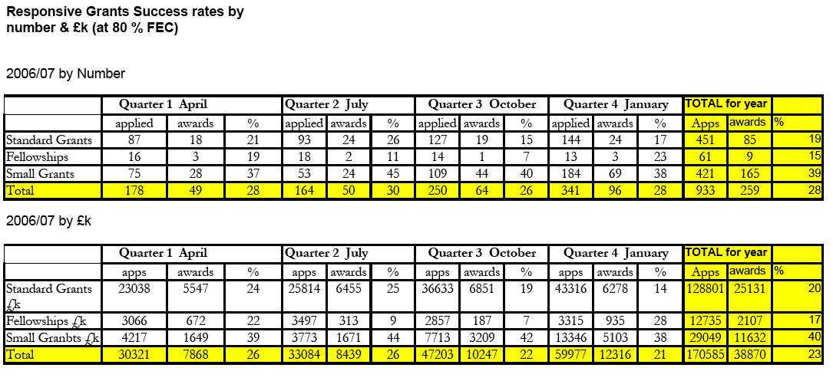
Notes:
14-16% for standard grants; 25-28% for small grants 2009.

Slide 13
CASE Studentships

Slide 14
Small Grants
Applications up to £99,999
Researchers attached to HEI can apply
Assessed by:
  ESRC staff (eligibility)
  Member of Research Grants Board
  Member of the ESRC Virtual College
Process takes approx 14 weeks

Slide 15
First Grant Scheme
Designed to allow new researchers to gain experience
Up to:
  3 years in length
  40% of investigator’s time
  £400,000 (FEC)
Must not have been a PI or Co-I on an existing ESRC award
Must be within 6 years of completing doctorate
(OR within 4 years if academic appointment immediately followed PhD)
Call opens once a year; next deadline is November 2009

Slide 16
Grants: you CANNOT apply for…
Unspecified research work
Research already carried out
Literature surveys
Solely general travel, seminars, conferences
Production of materials e.g. software
Preparation of books & publications
Writing up previous research
Notes:
For preparation of books & publications from previous research & for career development opportunities, it may be more appropriate to apply for a Research Fellowship. This has the same procedure, in terms of the application lifecycle, as a Standard Research Grant.

Slide 17
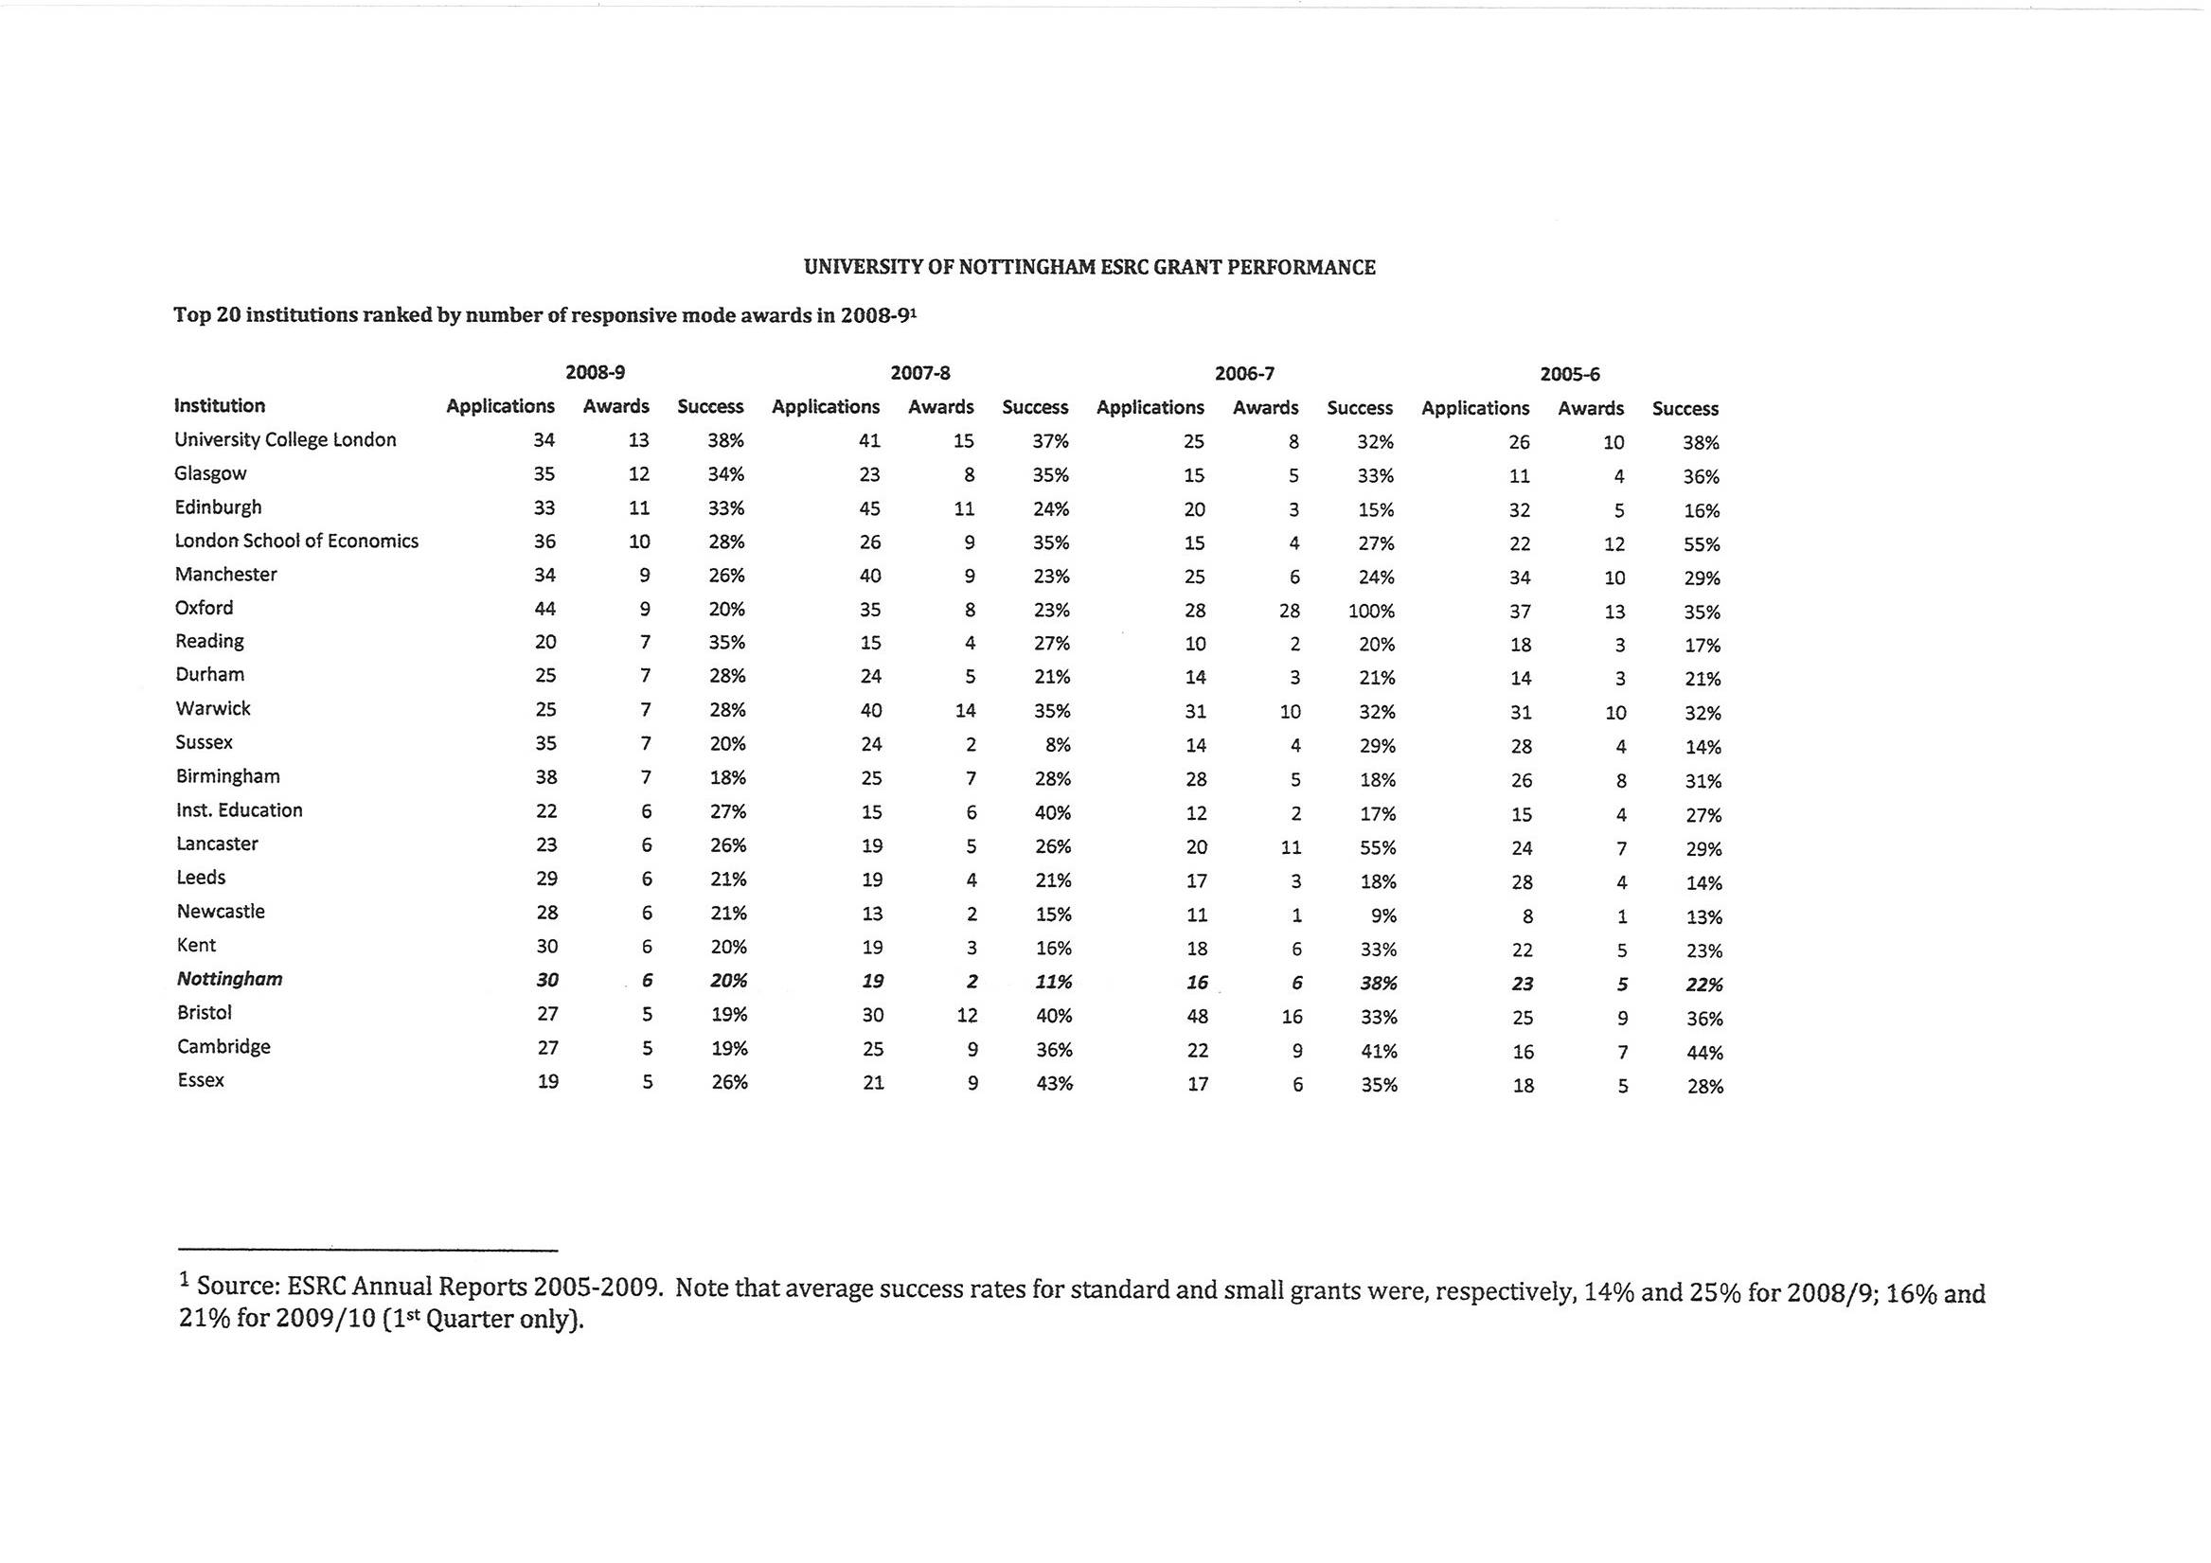

Slide 18
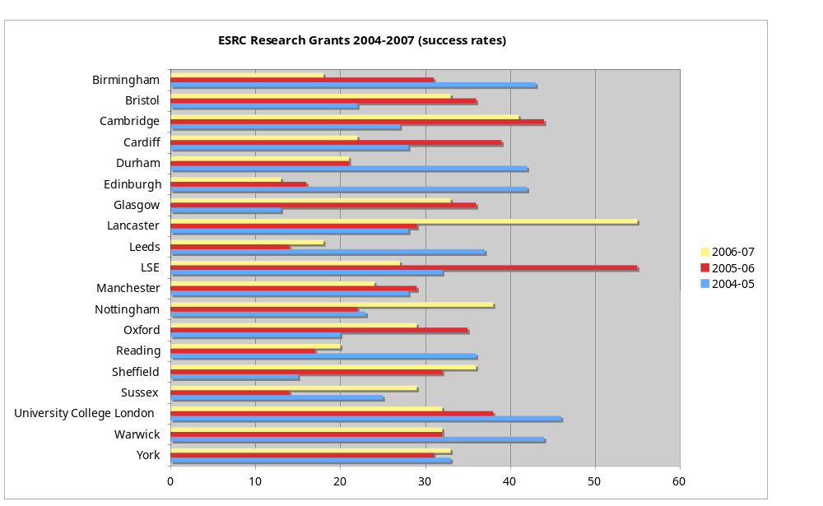
University of Nottingham - Success rates

Slide 19
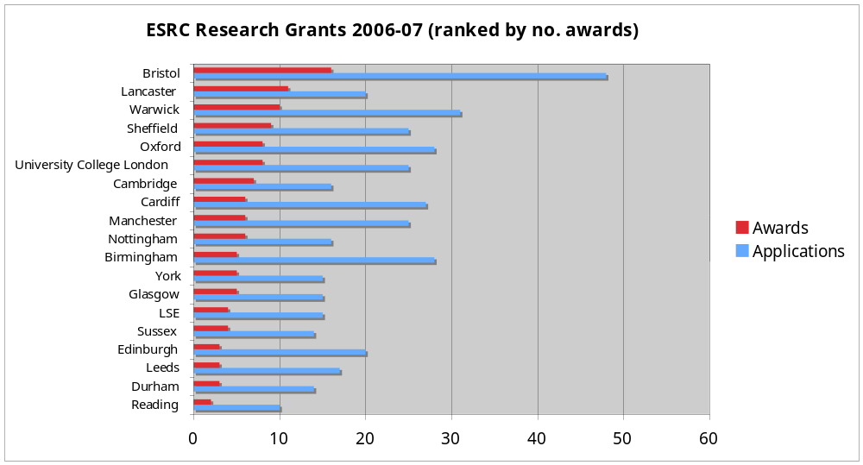
University of Nottingham - awards (2006-07)

Slide 20
Tips on applying to the ESRC
Four characteristics of all successful ESRC research grants are constant:
    promise excellent research
    demonstrate IMPACT: value to potential users outside or within the research community
    convince of the ability to deliver research
    demonstrate value for money (not necessarily the same as cheapness)

Slide 21
Tips on applying to ESRC
Allow yourself time
Study your funding source
Read the rules and the guidance notes
Discuss your application. Use HSSRC!
Consult with peers and referees
Mentoring (no matter how small the sum)
Justify your costings
Presentation matters
Build dissemination activities and impact plans into the structure of your research plan.
Write several drafts.
Notes:
NB: Consult with peers (grant mentoring schemes??)
Especially contact your nominated referees beforehand!!
Advice applies for all ESRC grants:
Apply in good time, especially if proposal is for a specific call.
Talk to university research office about full economic costing and allow time to do this.
Allow time for completion of institution submission process checks & authorisation – there is a further layer of administration between your submission of the application and its receipt by ESRC via JeS.
Submission via Je-S – you must be a registered user in Je-S; your institution will approve you.
Choose sensible nominated referees and contact them in advance. You cannot contact them regarding the application after its submission.

Slide 22
Tips on writing the application
Know your funding source:
Excellent research
Value to potential users
Ability to deliver research. IMPACT
Value for money
Refer to ESRC research funding rules
Get Je-S registration. Submit via Je-S (2 stages)
Become an ESRC reviewer
Notes:
Know the funding agency’s strategy
i.e. for ESRC:
Looking for excellent research
Clear methods which are state of the art & innovative
Anticipate user engagement & knowledge transfer and plan for it.
If a specific call, address the themes or research priorities
Value for money – be realistic – include expected salary and required equipment, data costs etc; don’t promise the earth for a tiny amount; don’t cut corners to promote economy at the expense of effectiveness.
However, if applying to first, small, standard or large grants – do not need to explain at length the relevance to ESRC research challenges.

Slide 23
Tips on writing the application
Content:
Formulate the problem
Aims & objectives
Research design & methods
Data collection & analysis
Potential users & user engagement
Content:
Ethical considerations
Potential difficulties
Bibliography
Dissemination strategy
Fits with guidance notes
Skills & competencies
Notes:
Don’t rely on description. Instead, the key points to remember is that referees can only read what you put in your application; don’t assume people will infer details/facts.
Can organise case for support into sub-headings, as suggested in research funding guidelines
Clearly state what you are planning and make sure you get the following across…
Why is the topic important
Are your research questions/ is your hypothesis clear?
Are your research methods clear? Are they state-of-the art and innovative?
Are dissemination methods innovative?
Show a timeline for research.

Slide 24
Tips on writing the application
Content:
Convey to the Board your genuine interest, understanding and enthusiasm for the work
    what is the story you are telling
    what is the audience
    why does it matter
    why now
    why you
    Do not assume expert readers.
Notes:
Remember that Board assessors are not necessarily experts in your field so use the non-tech summary to get the story across.
BUT: don’t make the mistake of spending so much time on selling the story that you don’t have space to say what you will do and how.

Slide 25
Tips on writing the application
Presentation:
Typeface point 12
6 side limit (12 sides if over £1m)
Plain English
Check spelling, grammar, readability etc
Provide appropriate attachments (in addition to case for support):
  Justification of resources (explanation of costings)
  References
  CVs
  Technical annex (if appropriate)

Slide 26
Application checklist
Have I:
established appropriate aims and objectives?
provided a well thought-out research design?
given a full and detailed description of the proposed methods?
demonstrated a clear and systematic approach to the analysis of data collection?
considered already existing resources?
thought about ethics?
recognised and planned for all the skills and competencies required?
are these skills and competencies reflected in the proposal’s research team?

Slide 27
Application checklist
Have I:
anticipated potential difficulties and addressed them?
fully defended my chosen research design against critical appraisal?
identified potential users and thought about how to engage them?
provided a clear dissemination strategy?
provided a bibliography?
looked at the ESRC’s guide on how to write a good application form?
Have I checked, checked and checked again?

Slide 28
Referee Grading
ALPHA +
ALPHA
ALPHA –
BETA
REJECT
All applications with an average grade of A-minus or above are forwarded to the Board for consideration
Applications receiving an average referee grade of below A-minus are normally rejected without referral to the Board
Resubmissions?
Notes:
ALPHA + The application is outstanding in terms of its potential scientific merit.
ALPHA The application is important as it has considerable potential merit, but does not warrant an A+ rating.
ALPHA - The application has significant potential scientific merit but is not of a consistently high quality.
BETA A Beta grade should be awarded to a proposal which will add to understanding and is worthy of support, but is of lesser quality or urgency than an alpha-rated proposal. Such proposals are unlikely to have a significant influence on the development of the research area.
REJECT A Reject grade should be awarded to a proposal which is flawed in its scientific approach, or is repetitious of other work, or otherwise judged not worth pursuing; or which, though possibly having sound objectives, appears seriously defective in its methodology.

Slide 29
Assessor Grading
A1 - outstanding scientific merit/contribution
A2 - significant value; important scientific contribution
A3 - High/Middle/Lower: considerable value; potentially important scientific contribution
A4 - some value; potential scientific contribution
A5 - some value; inconsistent quality
Beta - worthy of support; lesser quality/urgency
Reject - flawed; repetitious; technically defective
Notes:
Need to be scoring A2s to have a good chance of funding…..

Slide 30
Further information
Website:
http://www.esrcsocietytoday.ac.uk/ESRCInfoCentre/index.aspx
Funding rules: http://www.esrcsocietytoday.ac.uk/ESRCInfoCentre/opportunities/research%5Ffunding/
How to write a good application: http://www.esrcsocietytoday.ac.uk/ESRCInfoCentre/Support/research_award_holders/FAQs2/index1.aspx
Frequently Asked Questions: http://www.esrcsocietytoday.ac.uk/ESRCInfoCentre/How/researchers/

